Slide 1
Recitation 3
Brandon Lim, Carson Earl, Tristan Leerhoff, Charlie Ryan

Slide 2
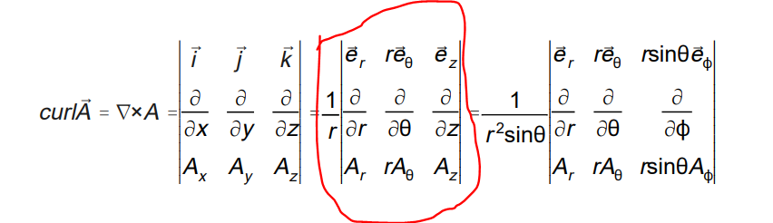
Part a)

Slide 3
Part b)
We know initial shape corner locations
(r,0), (r+dR,0),(r,dTheta),(r+dR,dTheta)
New shape corner locations after translation
Integral of V evaluated from 0 – 90 degree gives us positions shift of every corner
Evaluate shape change

Slide 4
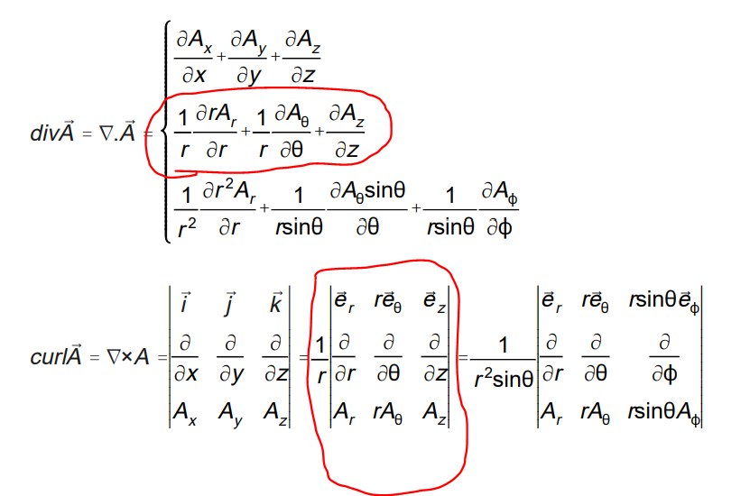
Part c)
distortion
rotation

